Slide 1
Deep Hole Drilling

Slide 2
What is a “Deep Hole”?
Any hole more than 5 diameters deep is a Deep Hole
Deep Holes are hard because:
Chip Clearing
Lubrication & Cooling
Tolerances: Position, Diameter, Straightness, & Finish

Slide 3
Deep Hole Techniques
< 5 Diameters
No worries!
5 - 7 xD
Peck
Drill
7 - 10 x D
Parabolic
Flutes +
Peck
> 10 x Diameters
Parabolic + Custom Drill Cycles
> 20 Diameters
Gun Drills &
Other Exotica
Limit: ~400
Diameters

Slide 4
Peck Drilling Strategies: > 5 Diameters
Above 5 diameters, start peck drilling
Short pecks up to 10 Diameters
Long Retract > 10 Diameters
Don’t retract clear of holes
Don’t peck carbide drills

Slide 5
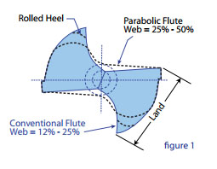
Parabolic Drills: > 7 Diameters
Geometry altered for better chip extraction
Better Feeds & Speeds
Deeper Holes

Slide 6
Custom Drill Cycles: > 10 Diameters
First Peck: 3 x D
Chip Break: 3 – 10 x D
Full Retract: > 10 x D
Peck Distance Reduces Each Peck
Tip Never Leaves Hole

Slide 7
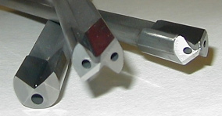
What’s To Do After 20 Diameters?
Gun Drills & Similar Approaches
Through tool high pressure coolant
Lots of chip clearance
Requires no reaming or honing
Up to 400x diameters deep!

Slide 8
Thanks!
Deep Hole Drilling

